Slide 1
Bayesian Models in Cognitive Neuroscience: A Tutorial
Author: Jill X. O’Reilly and Rogier B. Mars
Reporter: Xiaokai Xia

Slide 2
Abstract
What are the Bayesian models can do in neuroscience?

Slide 3
Abstract
Central feature
Represent the beliefs of an observer as probability distributions
Integrate uncertainty information
Using in neuroscience
Integrate evidence from different sources optimal
Develop beliefs by limited information

Slide 4
Introduction
Using between Bayesian and conventional statistics
And induce Bayesian in neuroscience

Slide 5
Conventional statistics
Probability — the measure of the likelihood
E.g. Toss a fair coin

Slide 6
Conventional statistics
Probability — the measure of the likelihood
E.g. Toss a fair coin
Unpredictable result in single experiment

Slide 7
Conventional statistics
Probability — the measure of the likelihood
E.g. Toss a fair coin
Unpredictable result in single experiment
Have statistical law in multiple experiment

Slide 8
Conventional statistics
Probability — the measure of the likelihood
E.g. Toss a fair coin
Unpredictable result in single experiment
Have statistical law in multiple experiment
Name | Experiment times | Times of head | The proportion of head
De Morgan | 4092 | 2048 | 50.05%
Buffon | 4040 | 2048 | 50.69%
William Feller | 10000 | 4947 | 49.47%
Romanovsky | 80640 | 39699 | 49.23%

Slide 9
Conventional statistics
Probability — the measure of the likelihood
E.g. Toss a fair coin
Unpredictable result in single experiment
Have statistical law in multiple experiment
Law of Large Numbers
Name | Experiment times | Times of head | The proportion of head
De Morgan | 4092 | 2048 | 50.05%
Buffon | 4040 | 2048 | 50.69%
William Feller | 10000 | 4947 | 49.47%
Romanovsky | 80640 | 39699 | 49.23%

Slide 10
Bayesian statistics
Using unreliable data
Accumulate evidence gradually

Slide 11
Key feature of Bayesian
Represent beliefs as probability distribution
Weight different sources of information according to their uncertainty
Interpret new observations in the light of prior knowledge

Slide 12
The deﬁning features of a Bayesian model
Try and infer causes from their observed effects

Slide 13
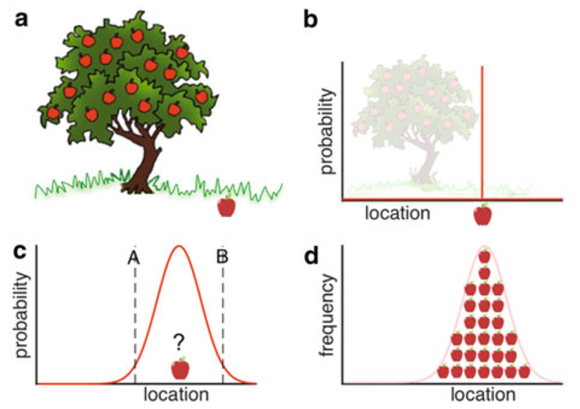
Represent Beliefs as Probability Distributions
Understanding data
a range of possible causes for the observed data
Represents beliefs as a probability density functions (pdf)

Slide 14

Represent Beliefs as Probability Distributions
Understanding data
a range of possible causes for the observed data
Represents beliefs as a probability density functions (pdf)

Slide 15
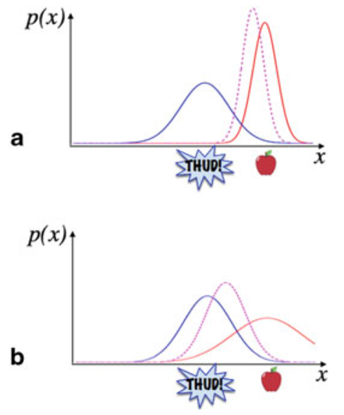
Integrate Information Using Uncertainty
Integrate data
There are multiple source of data in the world
The width of pdf represents the degree of uncertainty

Slide 16
Integrate Information Using Uncertainty
Integrate data
There are multiple source of data in the world
The width of pdf represents the degree of uncertainty

Slide 17
Integrate Information Using Uncertainty
Integrate data
There are multiple source of data in the world
The width of pdf represents the degree of uncertainty

Slide 18
Integrate Information Using Uncertainty
Integrate data
There are multiple source of data in the world
The width of pdf represents the degree of uncertainty

Slide 19
Integrate Information Using Uncertainty
The probability of the apple‘s location:
Highest at the two distributions overlap
The mode(peak) of the combined distribution lies closer to the mode of the distribution with the lowest variance

Slide 20
Integrate Information Using Uncertainty
The probability of the apple‘s location:
Highest at the two distributions overlap
The mode(peak) of the combined distribution lies closer to the mode of the distribution with the lowest variance

Slide 21
Interpret New Information in the Light of Prior Knowledge
E.g.
We may know something about the location of the apple

Slide 22


Interpret New Information in the Light of Prior Knowledge
E.g.
We may know something about the location of the apple

Slide 23
Interpret New Information in the Light of Prior Knowledge
E.g.
We may know something about the location of the apple

Slide 24
Interpret New Information in the Light of Prior Knowledge
E.g.
We may know something about the location of the apple

Slide 25
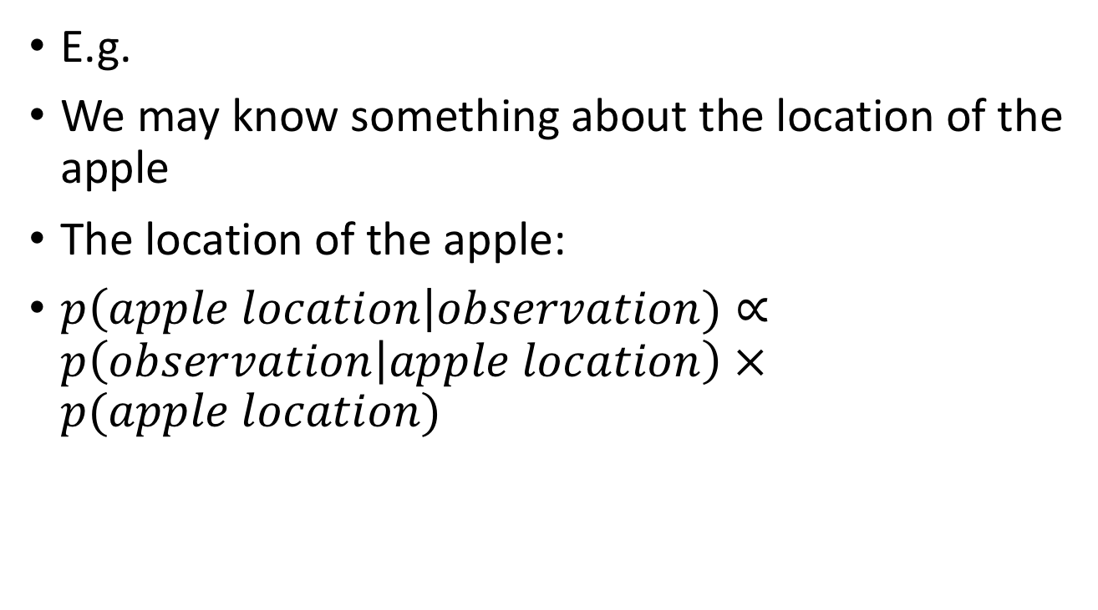
Interpret New Information in the Light of Prior Knowledge
E.g.
We may know something about the location of the apple
The location of the apple:
$p\left(apple location\right|observation)∝p\left(observation | apple location\right) ×p(apple location)$

Slide 26
Interpret New Information in the Light of Prior Knowledge
E.g.
We may know something about the location of the apple
The location of the apple:
$p\left(apple location\right|observation)∝p\left(observation | apple location\right) ×p(apple location)$
posterior
likelihood
prior

Slide 27
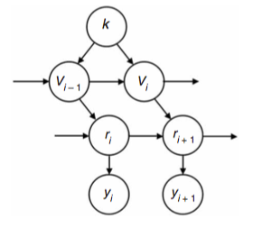
Priors and Learning

Slide 28
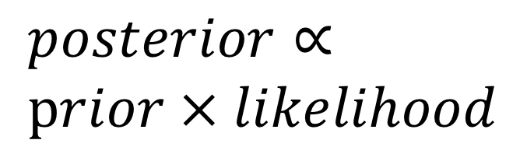
Priors and Learning
$posterior∝$
$prior × likelihood$

Slide 29
Priors and Learning
$posterior∝$
$prior × likelihood$
Learning

Slide 30
By using Bayesian model,
we look a person as a learner,
rather than a clairvoyant.

Slide 31
Learning
How to represent the Bayesian thinking in neuroscience

Slide 32
Example1 : The location of the apple

Slide 33
Example1 : The location of the apple

Slide 34
Example1 : The location of the apple

Slide 35
Example1 : The location of the apple

Slide 36
Example1 : The location of the apple
Gaussian Distribution

Slide 37
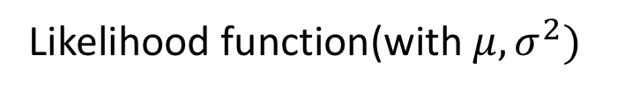
Example1 : The location of the apple
Likelihood function(with $μ, σ^{2})$

Slide 38

Example1 : The location of the apple
Updating of likelihood function(with $μ, σ^{2})$

Slide 39
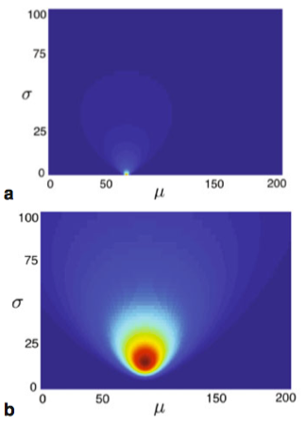
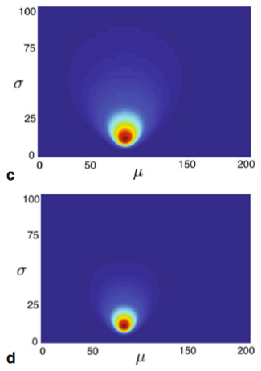
In the Mind of Our Bayesian Participant

Slide 40
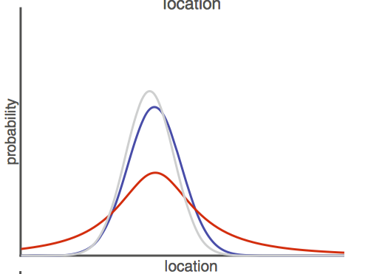
In the Mind of Our Bayesian Participant
maximum a posteriori (MAP) estimate

Slide 41

In the Mind of Our Bayesian Participant
Weighted sum

Slide 42
Bayesian statistics
Using unreliable data
Accumulate evidence gradually

Slide 43
Example2: One-armed Bandit
One-armed bandit task
Choose between A and B
Only one of action would lead to delivery of a reward
The probability that action A is rewarded is set at q
During the task, the value of q will changed
Probability v of a change in q

Slide 44
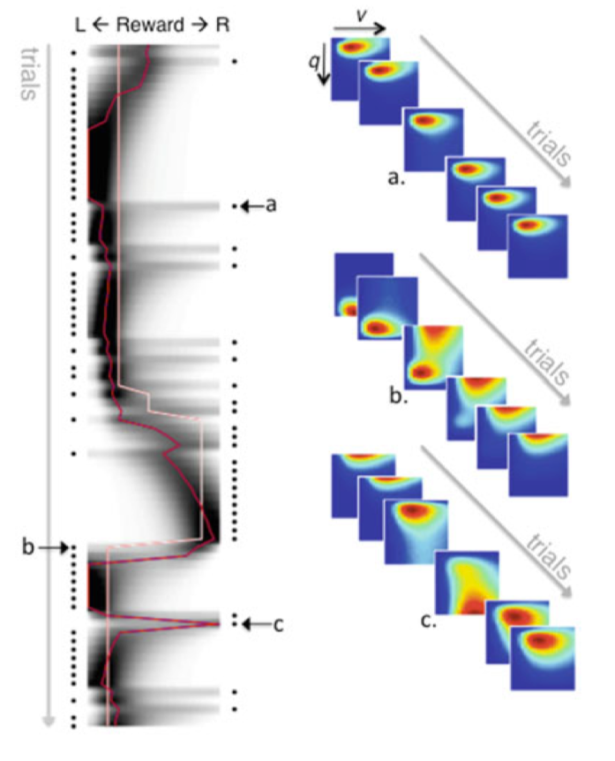

Slide 45
Example2: One-armed Bandit

Slide 46
Example2: One-armed Bandit
The maximum likelihood estimate is close to the true value of q most of the time
The model’s uncertainty decreases over time (convergence)
Can using prior to interpret new observations

Slide 47
Conclusion
Main features of Bayesian models
Representation of beliefs as probability distributions
The use of priors
Sequential updating of information
Predictive of the actual behavior displayed by humans
The parameters of Bayesian model can interrogate
Behavior
Brain function

